Slide 1
Text Generation
By team AVENGERS

Slide 2
Preview
Introduction
Data preprocessing
Training the model
Generation of text
User interface
Conclusion

Slide 3
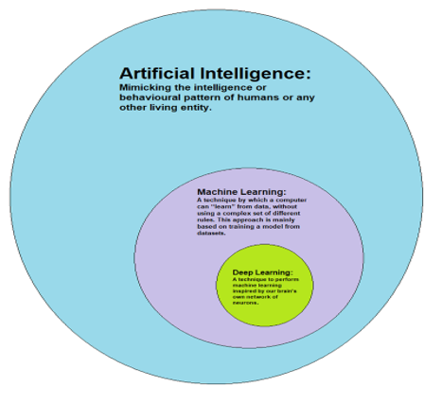
Introduction
Deep Learning : It is a subfield of machine learning concerned with algorithms inspired by the structure and function of the brain called artificial neural networks.
Artificial Intelligence : Artificial intelligence (AI) is the simulation of human intelligence processes by machines, especially computer systems. These processes include learning (the acquisition of information and rules for using the information), reasoning (using rules to reach approximate or definite conclusions) and self-correction.

Slide 4
Recursive Neural Networks,What and why?
A recurrent neural network (RNN) is a class of artificial neural network where connections between nodes form a directed graph along a temporal sequence.
Unlike feed forward neural networks, RNNs can use their internal state (memory) to process sequences of inputs.
Basic RNNs are a network of neuron-like nodes organized into successive "layers", each node in a given layer is connected with a directed (one-way) connection to every other node in the next successive layer.

Slide 5
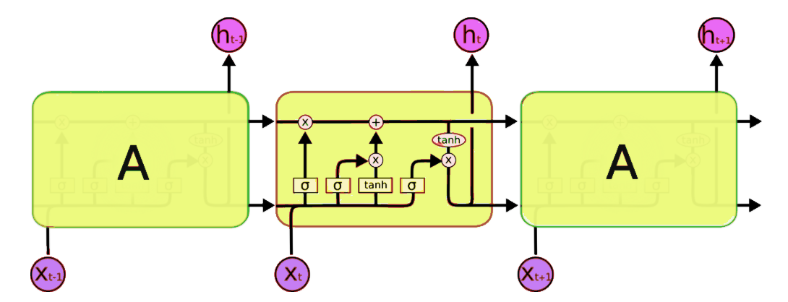
Long Short Term Memory
Long short-term memory (LSTM) is an artificial recurrent neural network (RNN) architecture used in the field of deep learning.
A common LSTM unit is composed of a cell, an input gate, an output gate and a forget gate.
It can not only process single data points (such as images), but also entire sequences of data (such as speech or video).

Slide 6
Data preprocessing
Extracting all the headlines of the articles in to a list
Removing all punctuations
Converting all letters into lowercase
Tokenizing the headlines
Pading the sequence
This is followed by Model fitting and then saving it

Slide 7
Generation and User interface
We have imported tkinter library for designing the User interface
Generating labels, buttons and defining their functionality

Slide 8
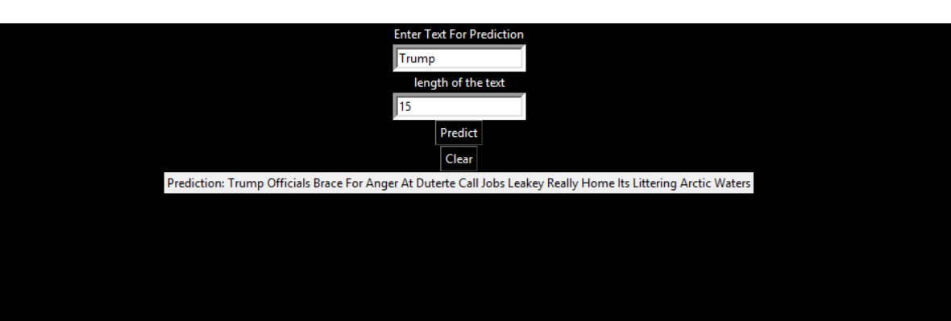
Photocopy of program before deploying

Slide 9
CONCLUSION
Uses of our project
Some existing real time applications
Findings and what are all the improvements we can do in this model
Fine tuning the architecture
Linking this with the other applications of Artificial Intelligence and Machine Learning

